Slide 1


December 2021

Slide 2
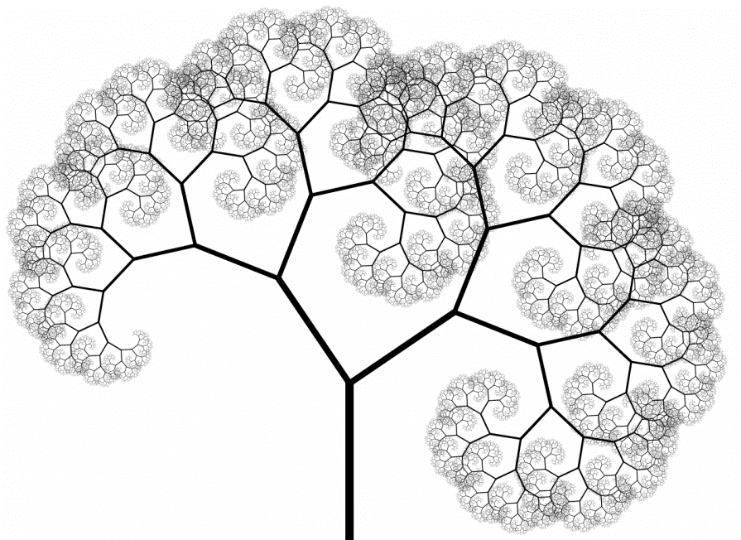




Our Global Ecosystem is an unparalleled source of impact solutions and innovation for Conduit Capital to incubate from idea to execution
The relationships of whole Conduit Ecosystem – members, impact partners, companies – provide deep and fertile opportunities for connections and engagement that produce innovative ideas.
Our variety of mission aligned stakeholders share the same purpose which fosters collaboration and engagement for deep value creation and sustained impact. They provide the knowledge, networks and capital needed to take these concepts from ideas to scaled success.
Subject Matter Experts
Robust Govt/Policy Relationships
Renowned Advisors
Impact Orgs/ Entrepreneurs
Impact Partners
~10,000
addressable
audience
made up of entrepreneurs, global institutions, large asset managers & foundations, governments, and many other impact partners
World-Class Speakers
Members
Dynamic Media Connections
>500,000 ppl
have had an interaction in 2yrs
The Conduit is a community of people who aim to change the world.
3x growth in ecosystem
targeted in next five years through additional clubs and networks, expanding our global reach
Community
Content
Action
3,500+ gender and diversity balanced global members & impact partners
7 core themes
250 annual events
3,500+ attendees
Global digital platform
Conduit Foundation
The Conduit Connect
Conduit Capital
Notes:
Growth in ecosystem is not just additive but exponential in value/benefit

Slide 3



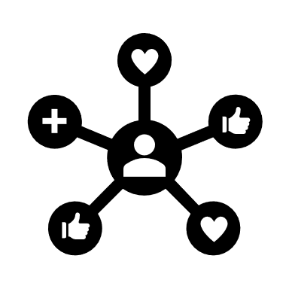
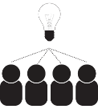
How it all works
Our impact allies are active across all stages of our products’ lifecycles.
This engaged global network gives us a competitive advantage and supports our long-term success.
Future Product Design &
Sectoral Leadership
Scale in Impact due to
Efficiency of Cost
Execution & Collaboration across Investment Strategies
Strategic
Exit
Fundraising
Accelerates value creation to generate better returns
Impact
Network
Value Creation
Outsized brand strength and influence
Deal Flow
Due
Diligence
De-risks our products through the collective wisdom of the ecosystem

Slide 4



Our impact network supports Conduit Capital’s product innovation process with pipeline, expertise, relationships and capital
New innovative
products that provide:
Impact/Social returns
Financial returns
Sectoral leadership
Initial Vetting
Investment and Impact Design
Product Development
Execution
Impact
Network
Conduit
Capital
Relationships/Networks
Expertise/Knowledge
Capital

