Slide 1
A Three Dimensional Urbanism
Eco-Technological Adventures

Slide 2
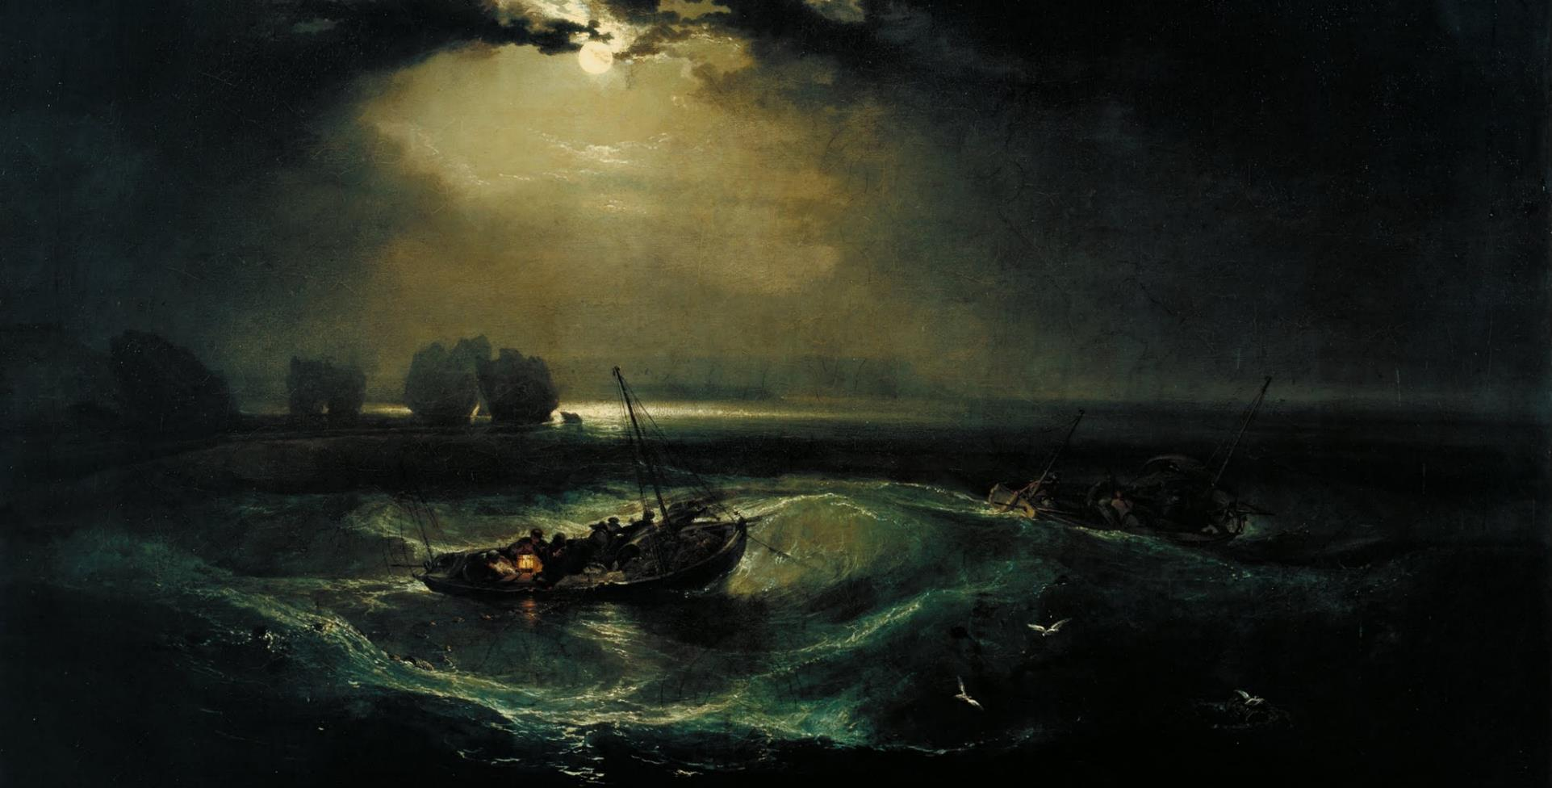
Fishermen at Sea, J.M.W. Turner 1796, his first oil painting first exhibited at the Royal Academy, London
Notes:
I love this painting and used it in some of my virtual presentations during the COVID lockdown.
Created at a time, when the world, particularly England, had been undergoing radical changed due to the 1st industrial revolution. This painting portrays fishermen, a traditional job to win ones bread (or fish) is now challenged by the rough sea and high waves. The darkness doesn’t help either … but there is light, a glimmer of hope, that the sun may well shine again..

Slide 3
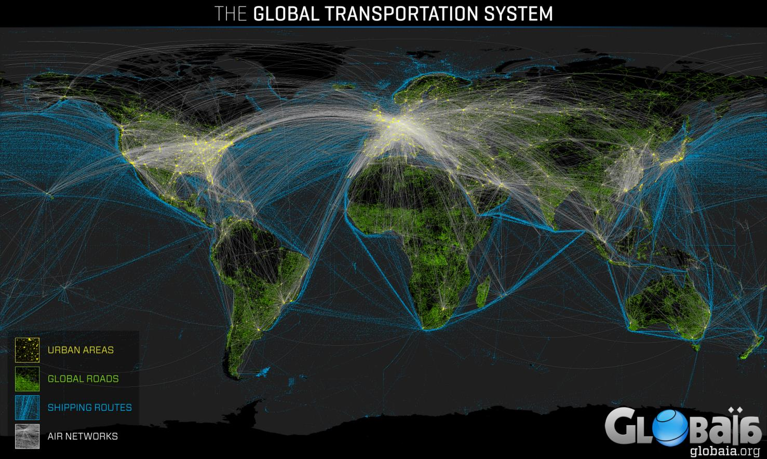
Notes:
Today the world has become gradually more interconnected
Vast global transportation systems on Land, Sea and Air connect us; we can now travel to distant continents and jump cities in a matter of hours
As a result of technological advancements, world population has increased 6- fold in the last 100 years.
Networks of communications and infrastructure expand and cities continue to become interconnected and interdependent.
Global migration has increased and we are now more nomadic than ever
Networks control our safety, hospital equipment; they are omnipresent

Slide 4
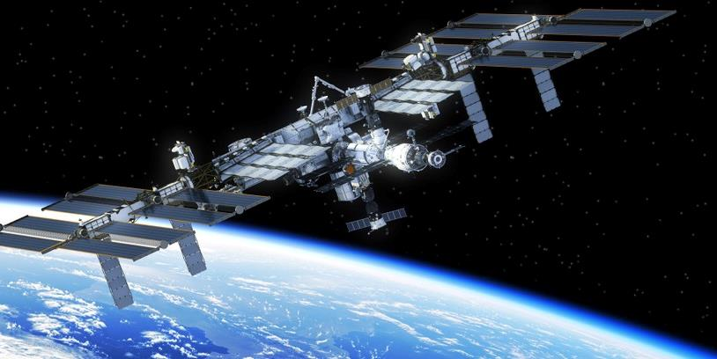
ANOMALIES Errors or systemic inconsistencies that give rise to new conditions or reveal new perceptions
THE INTERNATIONAL SPACE STATION A closed Human Life Support system

Slide 5
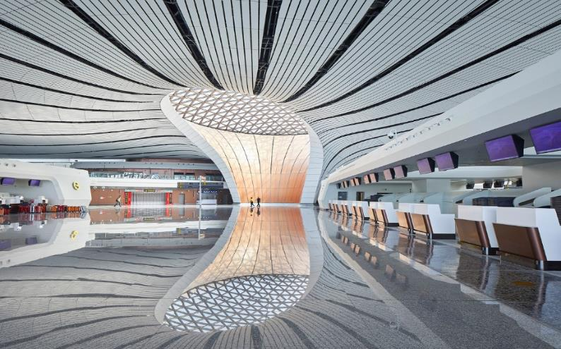
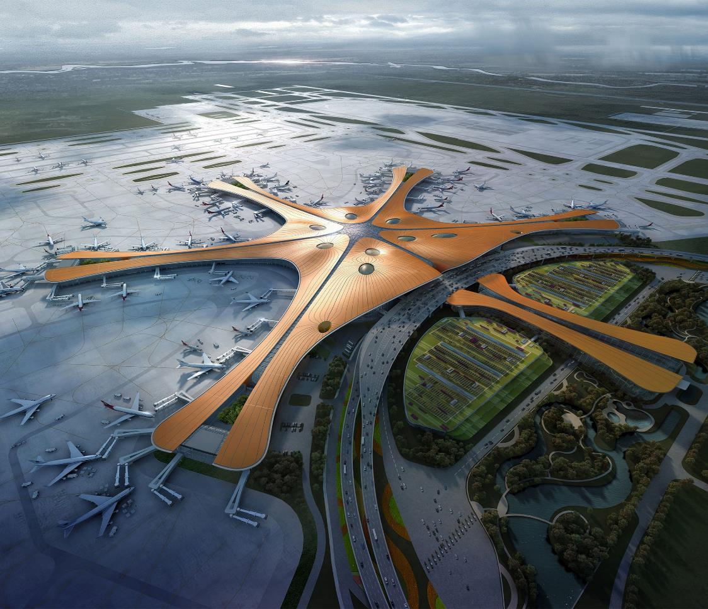
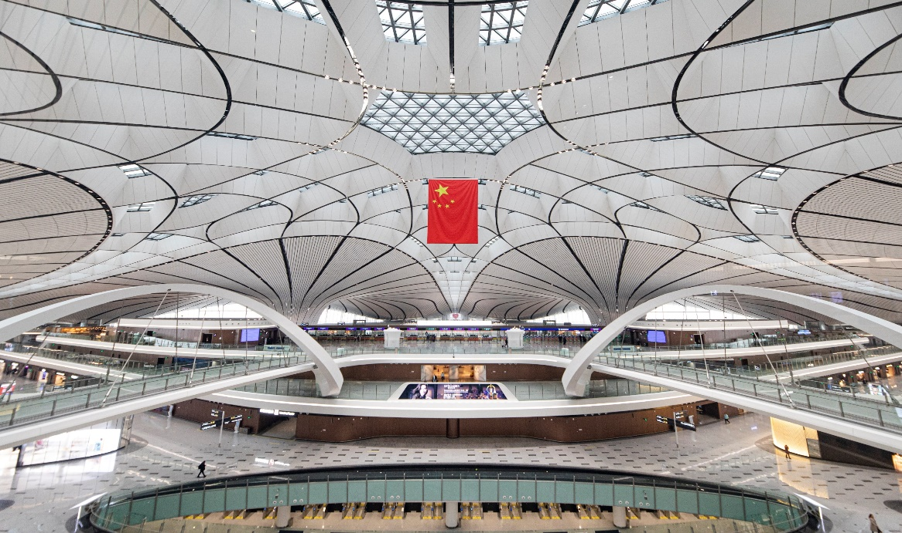
NEW INFRASTRUCTURE – Daxing Airport, Beijing
Notes:
BEIJING AIRPORT
The new Beijing Airport was designed and built in a record 5 years’ time. Its 700,000sq.m. Area serves up to 50m Passengers per year (the capacity of all of London Heathrow terminals together) at a cost of USD 11billion and can be seen from the ISS
It is the first airport to feature automatic check in and steward free access to the airside, using face-recognition technologies, it saves check-in time.

Slide 6
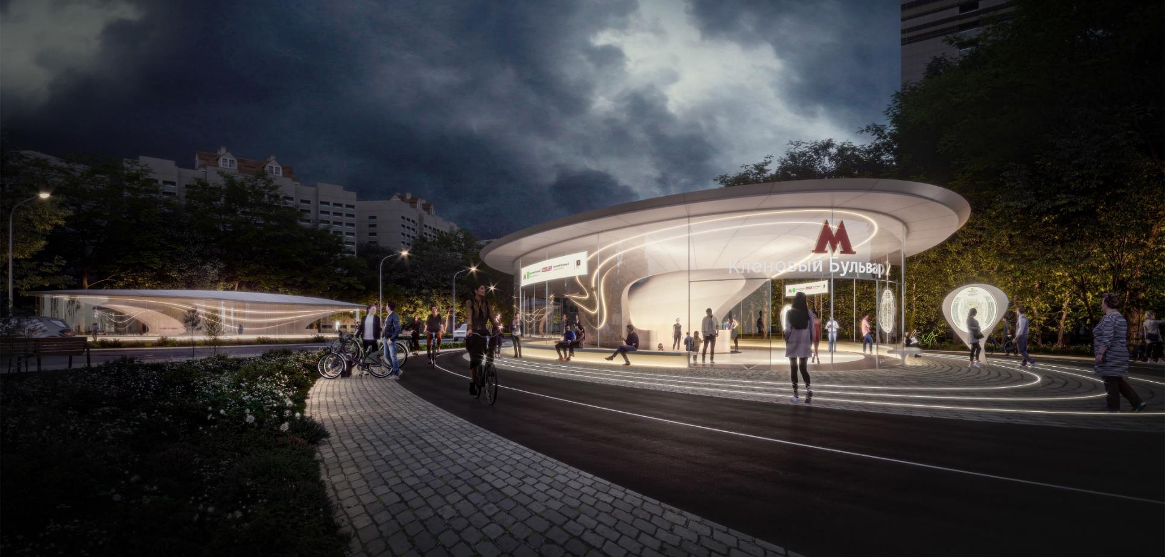
NEW INFRASTRUCTURE – Klenoviy Boulevard Metro Station, Moscow
Notes:
KLENOVIY BOULEVARD METRO STATION, MOSCOW
This is one of my favourites!
We won this design competition in 2020 for a station in one of Moscow’s suburbs.
The design approach aims to transform the outlook of the traditional soviet structures and the Metro operators asked us to look at rebranding what the locals call the People’s Museums.
Our response was to design a lightweight, transparent entrance and ticketing kiosk that preserves the iconic M that symbolizes the Moscow Metro system.
On the platform underground, we aim to integrate a lighting system controlled by sensors aiming to make the passengers travel safer and stress free using intuitive signalling to guide passengers to train locations.

Slide 7
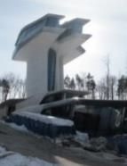
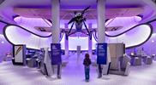
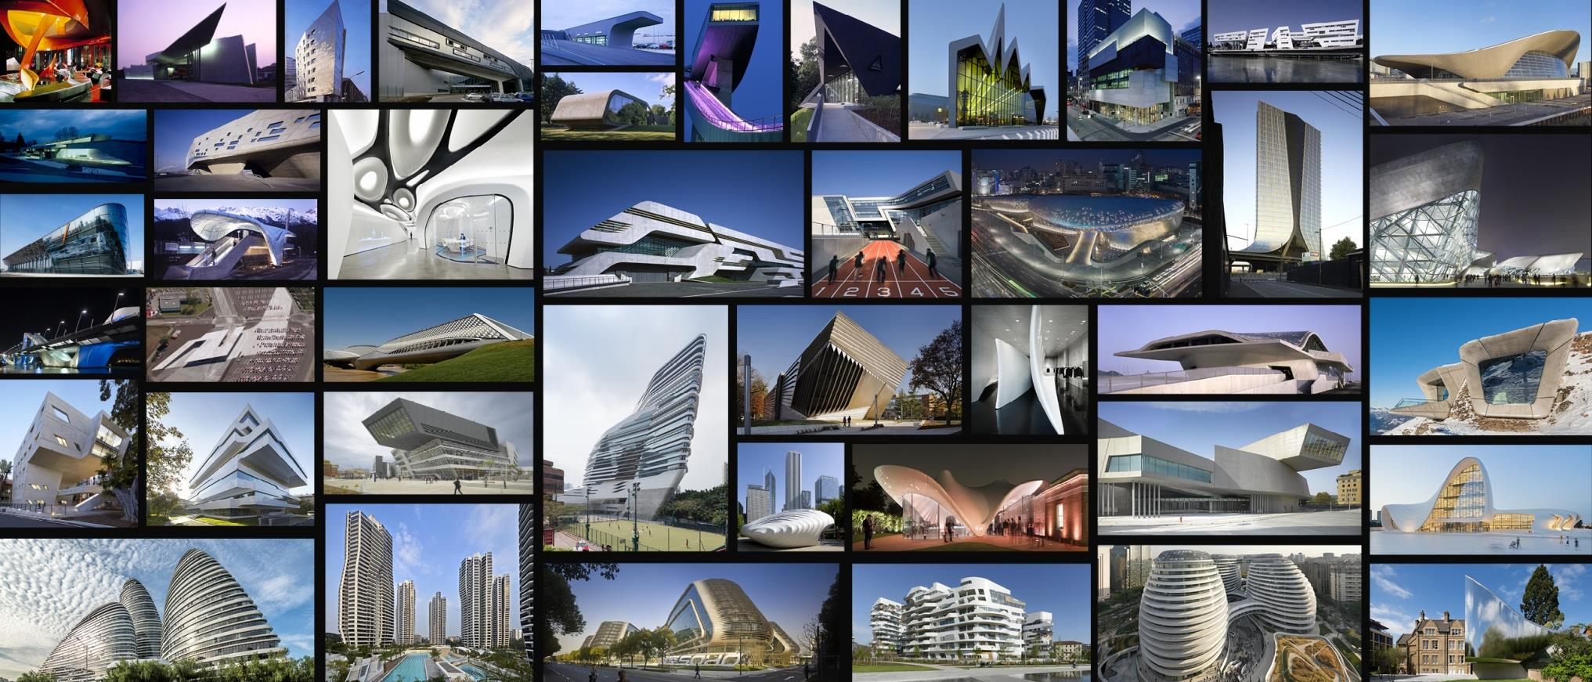
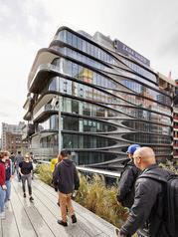

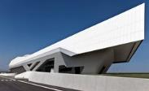
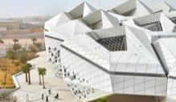
MASS CUSTOMIZATION Delivering Unique Formal Propositions For A Unique World
Notes:
Over the past 30 year, ZHA have been developing a new architectural language.
An architectural language that allowed us to differentiate each project, creating unique formal propositions for each unique project.

Slide 8
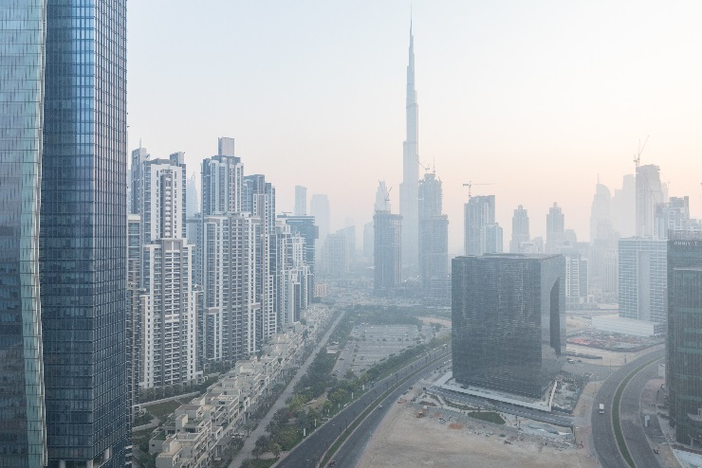
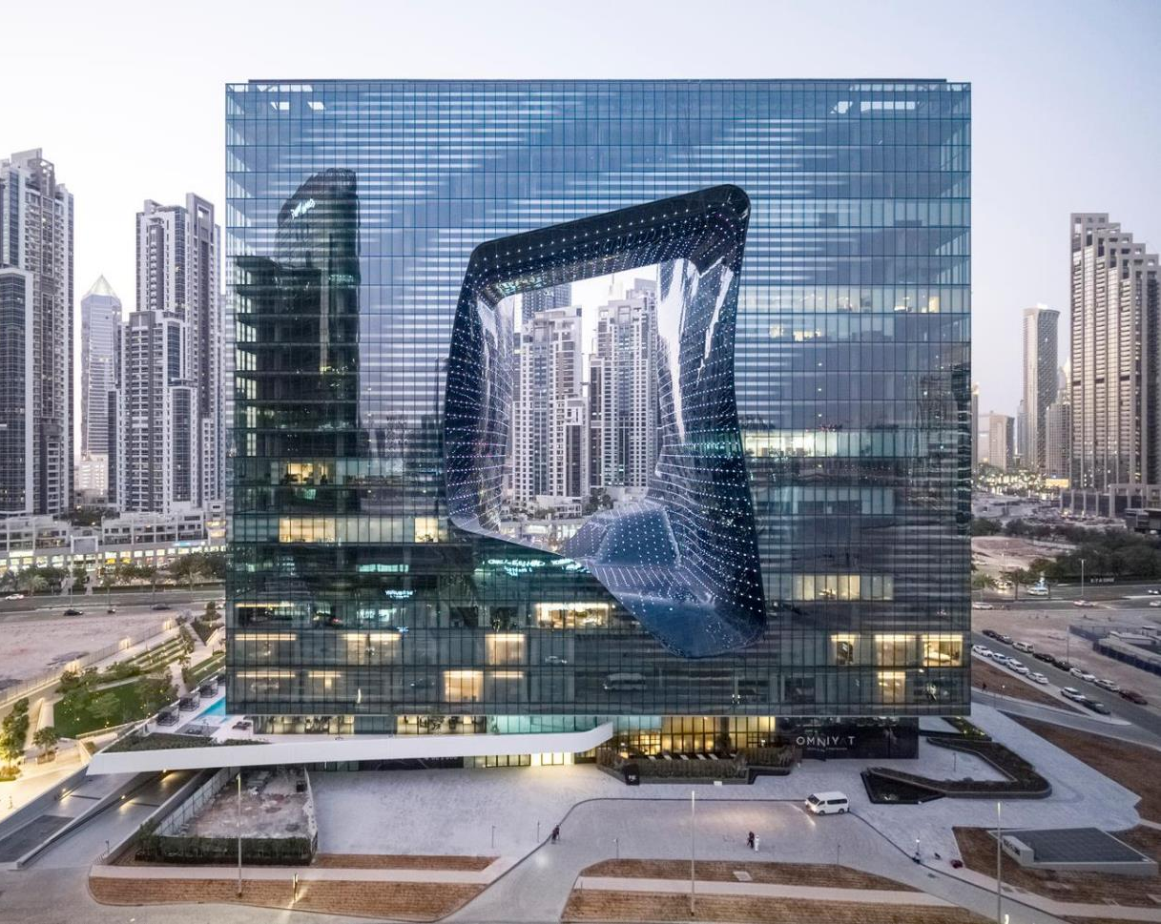
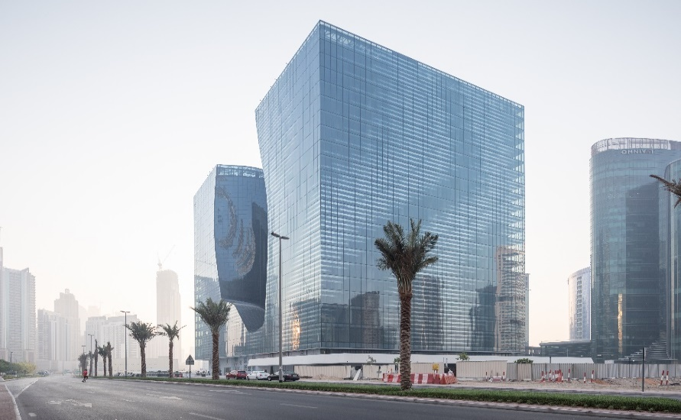
Contemporary Arab Urbanism Re-interpreting the void
OPUS, Dubai
Notes:
The OPUS in Dubai is a project that reinterpreted the idea of iconicity, by inverting what is special and making it absent. The project was originally meant to be two towers of 30 stories high. Instead we proposed to make a lower building with larger floor plates and unify the two towers with a bridge at the top and an atrium at the base.
This move, completely transformed the expectations and allowed us to deliver this result. It is a binary building that plays on the ideas of contrasting forms. The building has been designed inside and out by ZHA and the lower three levels feature a 5* boutique hotel operated by Melia.

Slide 9
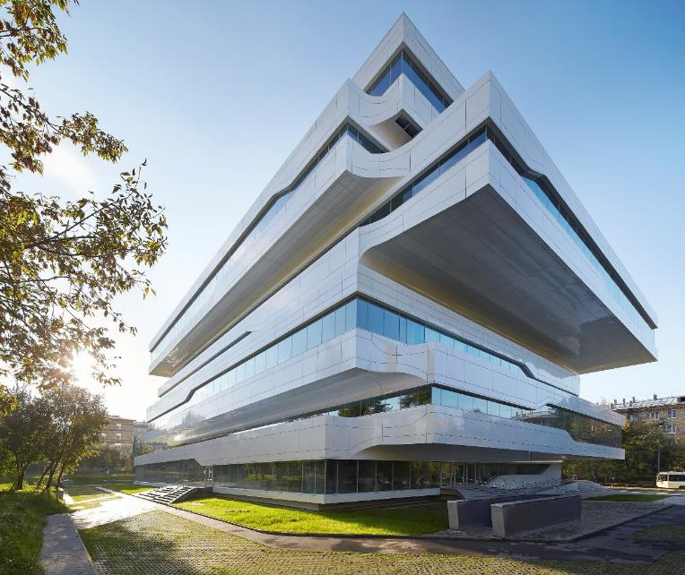
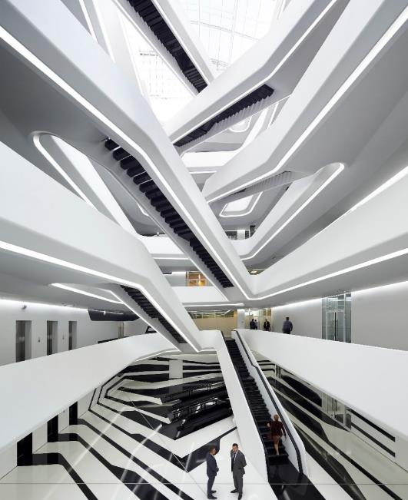
Contemporary Russian Urbanism Re-interpreting constructivist ideas
Dominion Plaza, Moscow
Notes:
The dominion Tower is a project that is based on ideas of early Russian Constructivist architecture. Long cantelivers, allowed us to make the spaces internally wider and allow for more flexible offices spaces. Panoramic windows offer views to the Moscow skyline. The building features a

Slide 10
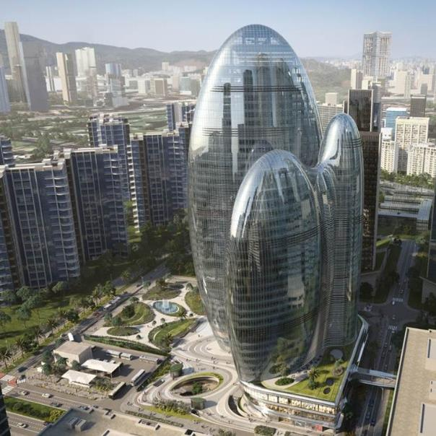
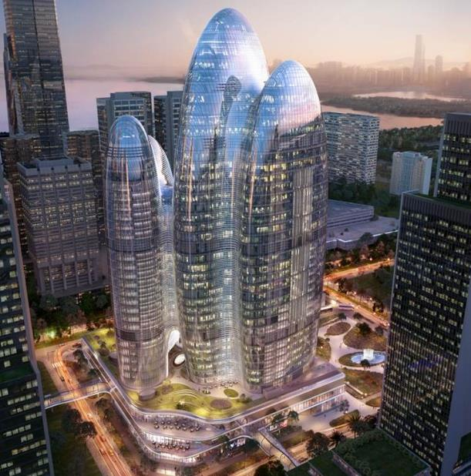
Contemporary Chinese Urbanism A flagship HQ for an emergent mobilie comms co
OPPO HQ, Shenzhen

Slide 11
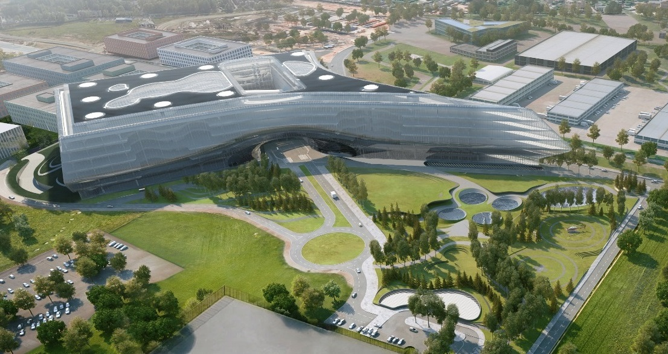
AGILE Spaces - Developing Workplace Ecosystems

Slide 12
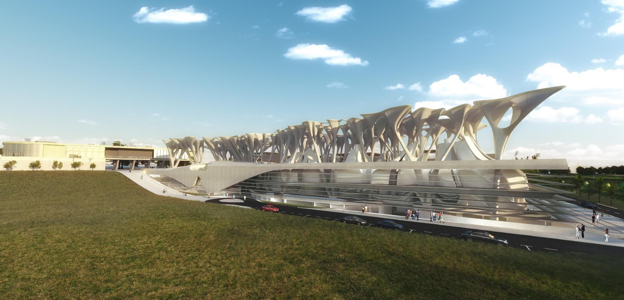
BIOCLIMATIC DESIGN – School of Biological Sciences, UCy
  BIOCLIMATIC Environment and climate driven design School of Biology (competition entry 2015), University of Cyprus

Slide 13
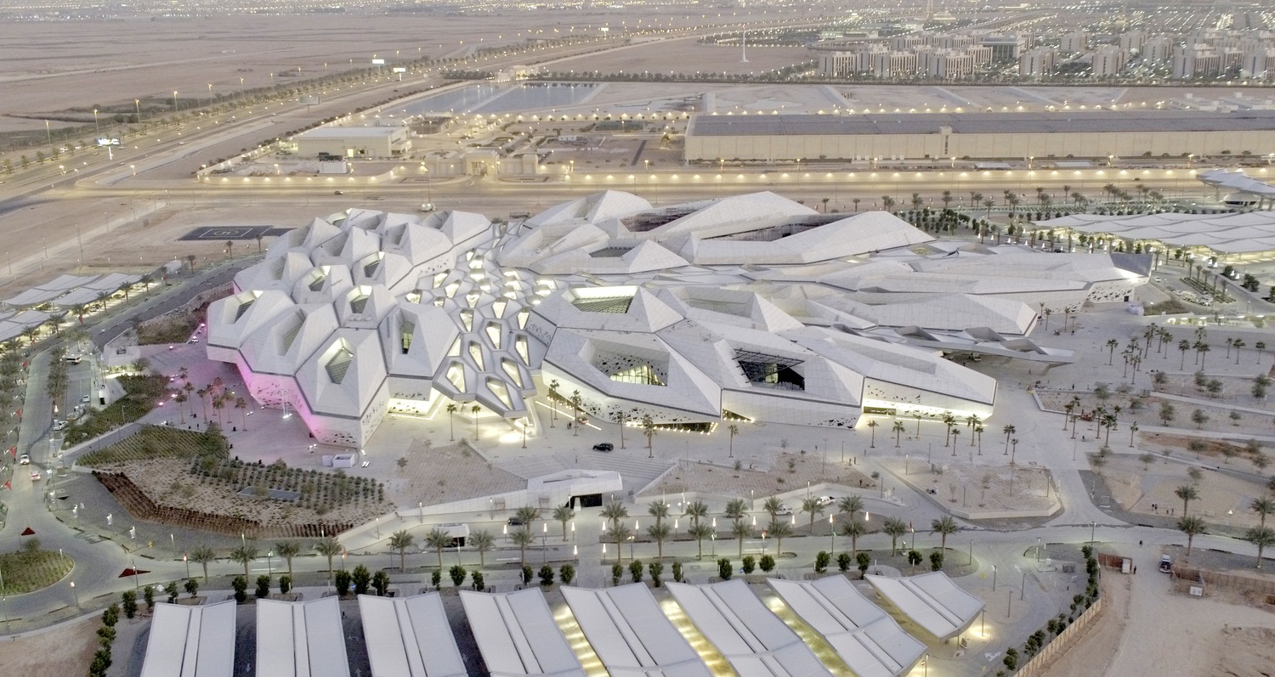
BIOCLIMATIC DESIGN – King Abdullah Petroleum studies and Research Center, Riyadh
  BIOCLIMATIC Environment and climate driven design KAPSARC Saudi ARAMCO (completed 2018), KSA

Slide 14
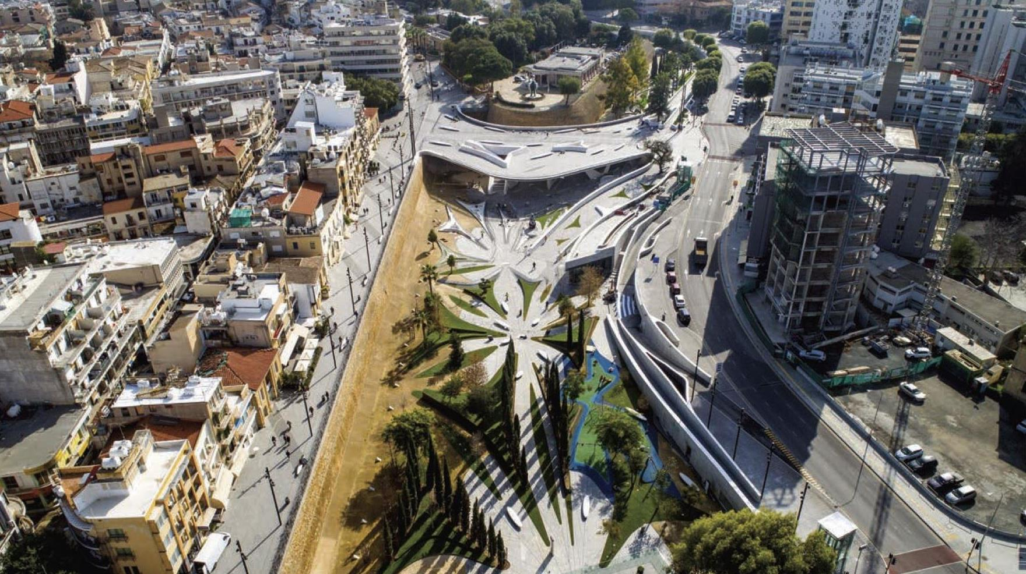
FREESPACE urban intervention projects that aim to re-instate liberated physical civic spaces Nicosia, Cyprus
Φωτο: Νέαρχος Παναγιώτου
Notes:
Eleftheria Square for some of us, has been a labour love. A project that took several years of perseverance and dedication and for good reason.

Slide 15
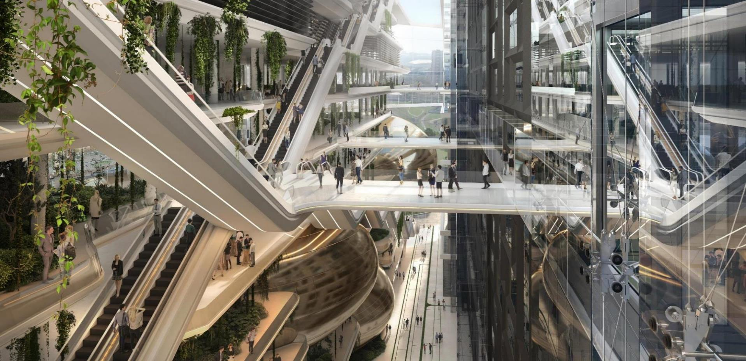
SBERBANK BUSINESS COMPLEX AND CULTURAL CENTRE, MOSCOW, RUSSIA
ECO-TECH BUILDINGS Buildings that contribute to the urban Civic Spaces

Slide 16
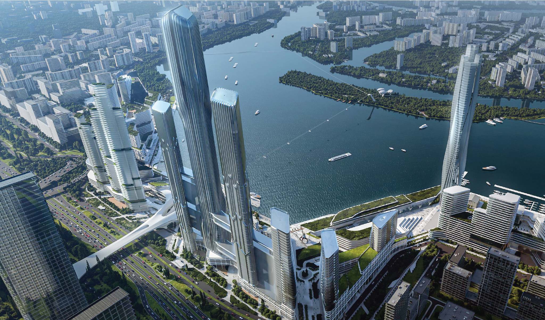
MOSCOW SOUTH-PORT, MOSCOW, RUSSIA
3D URBANISM Buildings that become part of a three-dimensional urban fabric

Slide 17
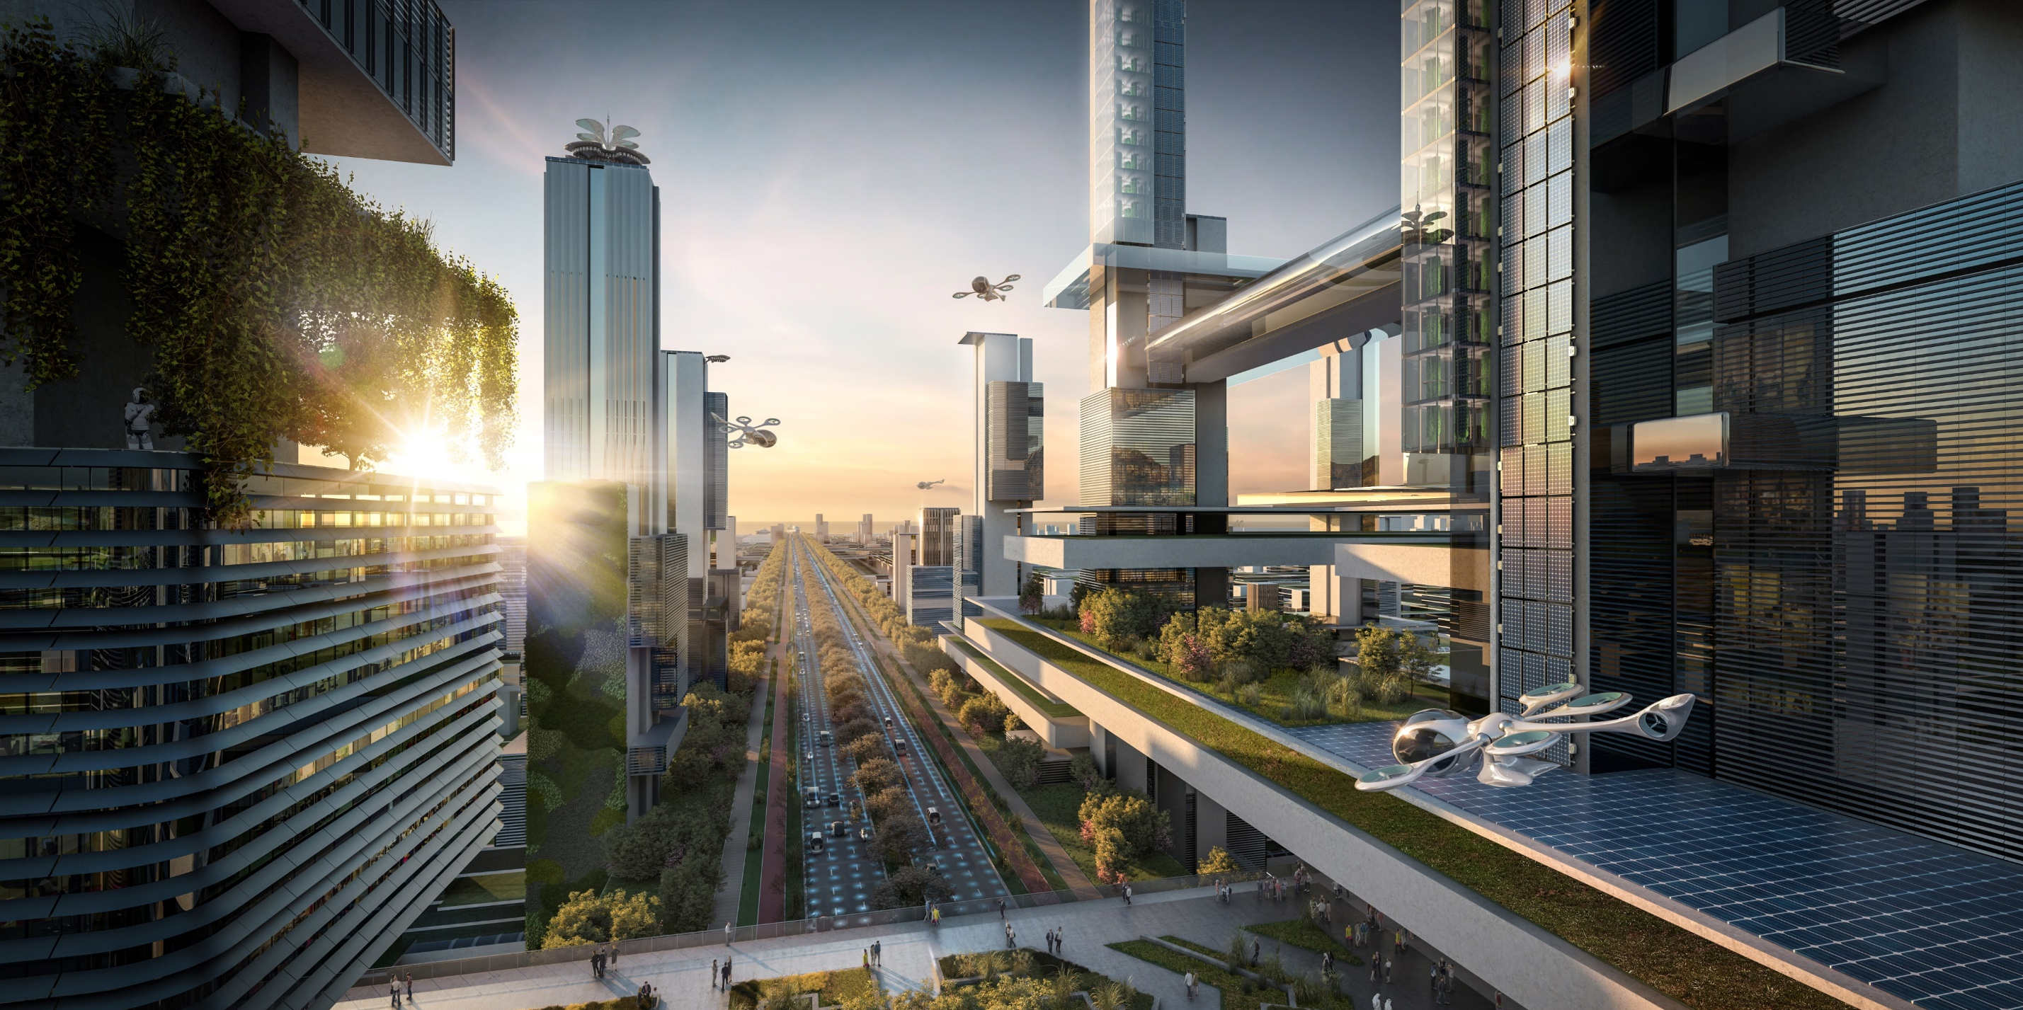
3D URBANISM Cities that blend ecology and technology

Slide 18
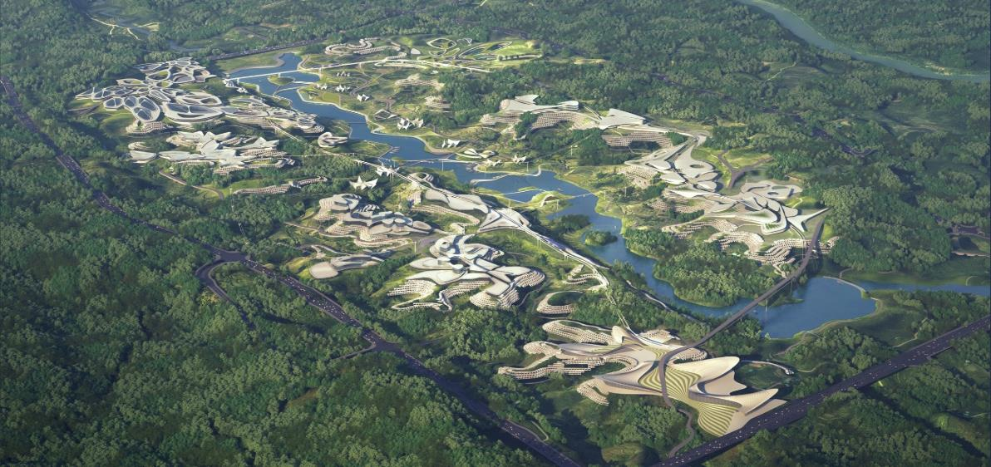
BIONIC Landscapes - Fusion of Architecture and Landscape
Chongqing Liangjiang New Area 2018

Slide 19
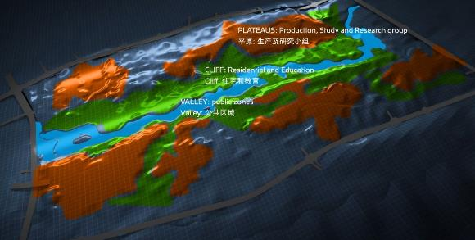
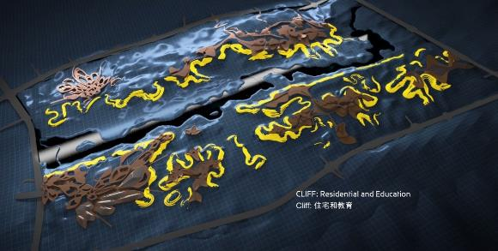
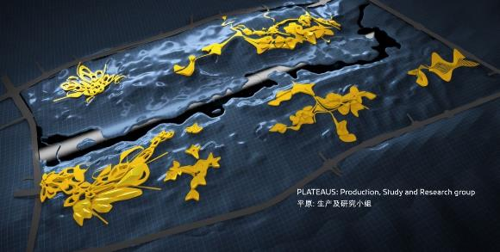
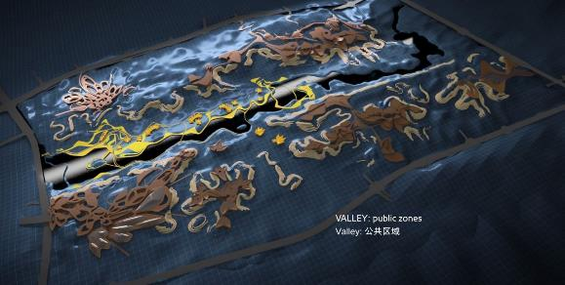
BIONIC Landscapes Fusion of Architecture and Landscape
Chongqing Liangjiang New Area 2018

Slide 20
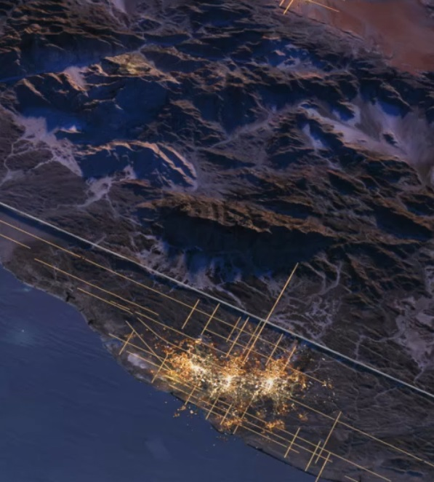
















Eco-Tech Urbanisms (new Vitality?) Fusion of Architecture and Landscape
Neom IC is a multi-faceted type of city
Tourism
Agriculture
Commerce
Maritime Industry
Marina
Education
Retail
Manufacturing
Culture
Labs
Healthcare
Robotics
Arts
Renewables
Fishing
AI

Slide 21
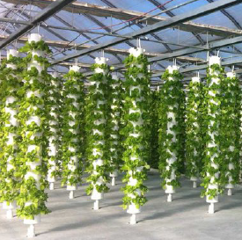
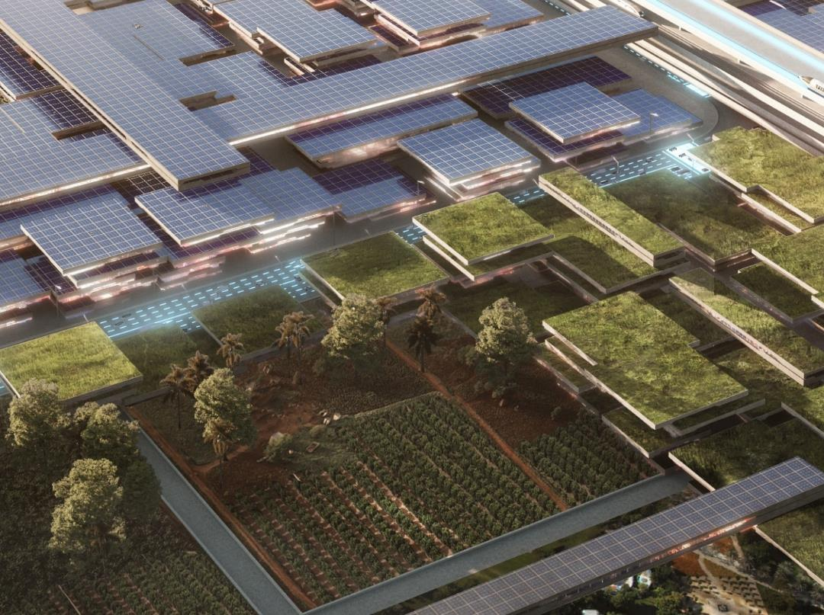
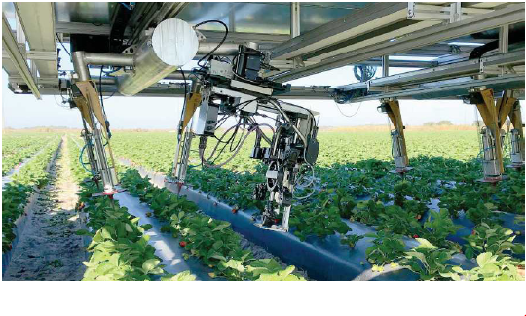
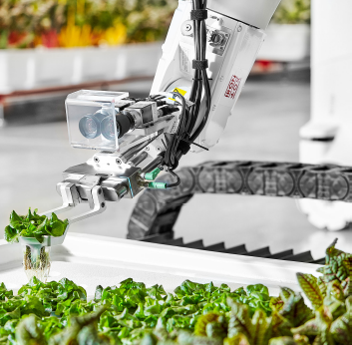
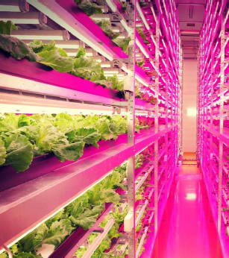
Eco-Technological Habitat bringing together clean energy and sustainable food production
FOOD INNOVATION HUB
Urban farming and enhanced agriculture (Farming areas in and surrounding the city)

Slide 22
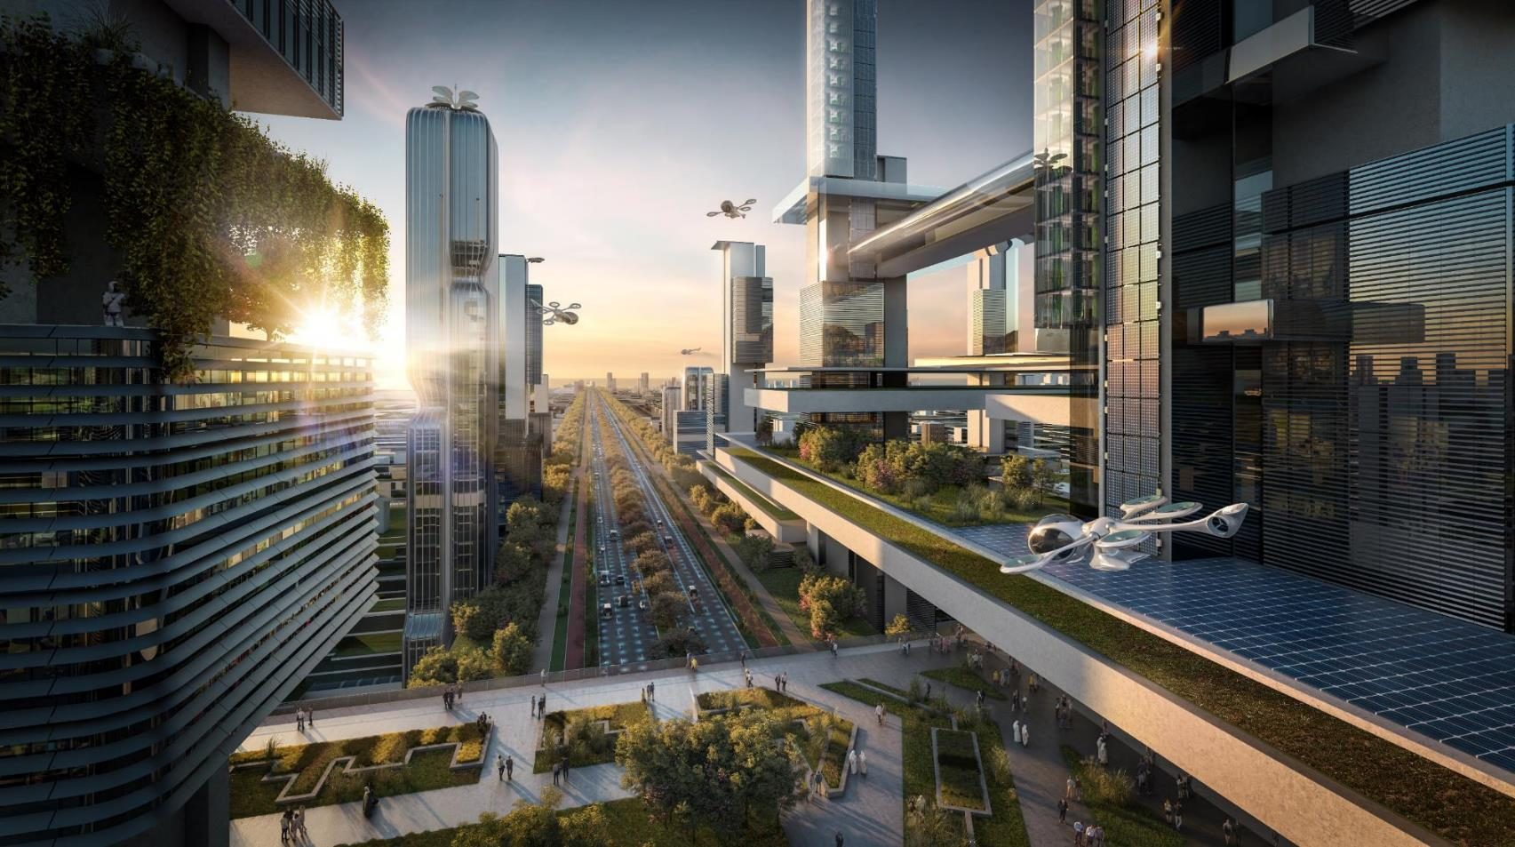
ECO-TECHNOLOGICAL HABITAT A new type of city?
Chongqing Liangjiang New Area 2018

Slide 23
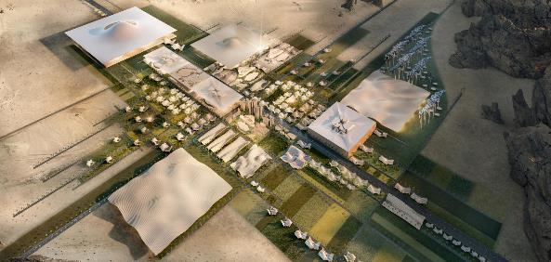
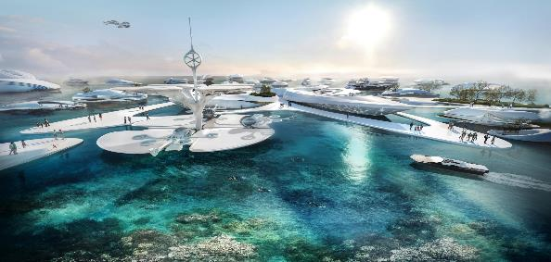
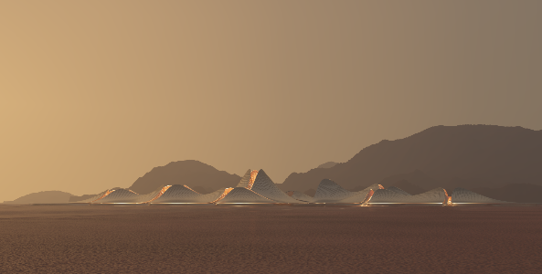
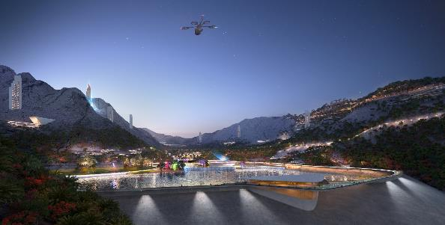
ECO-TECH habitats places for human interaction embedded in the local landscape
High-tech Agricultural citadel, 2018

Slide 24
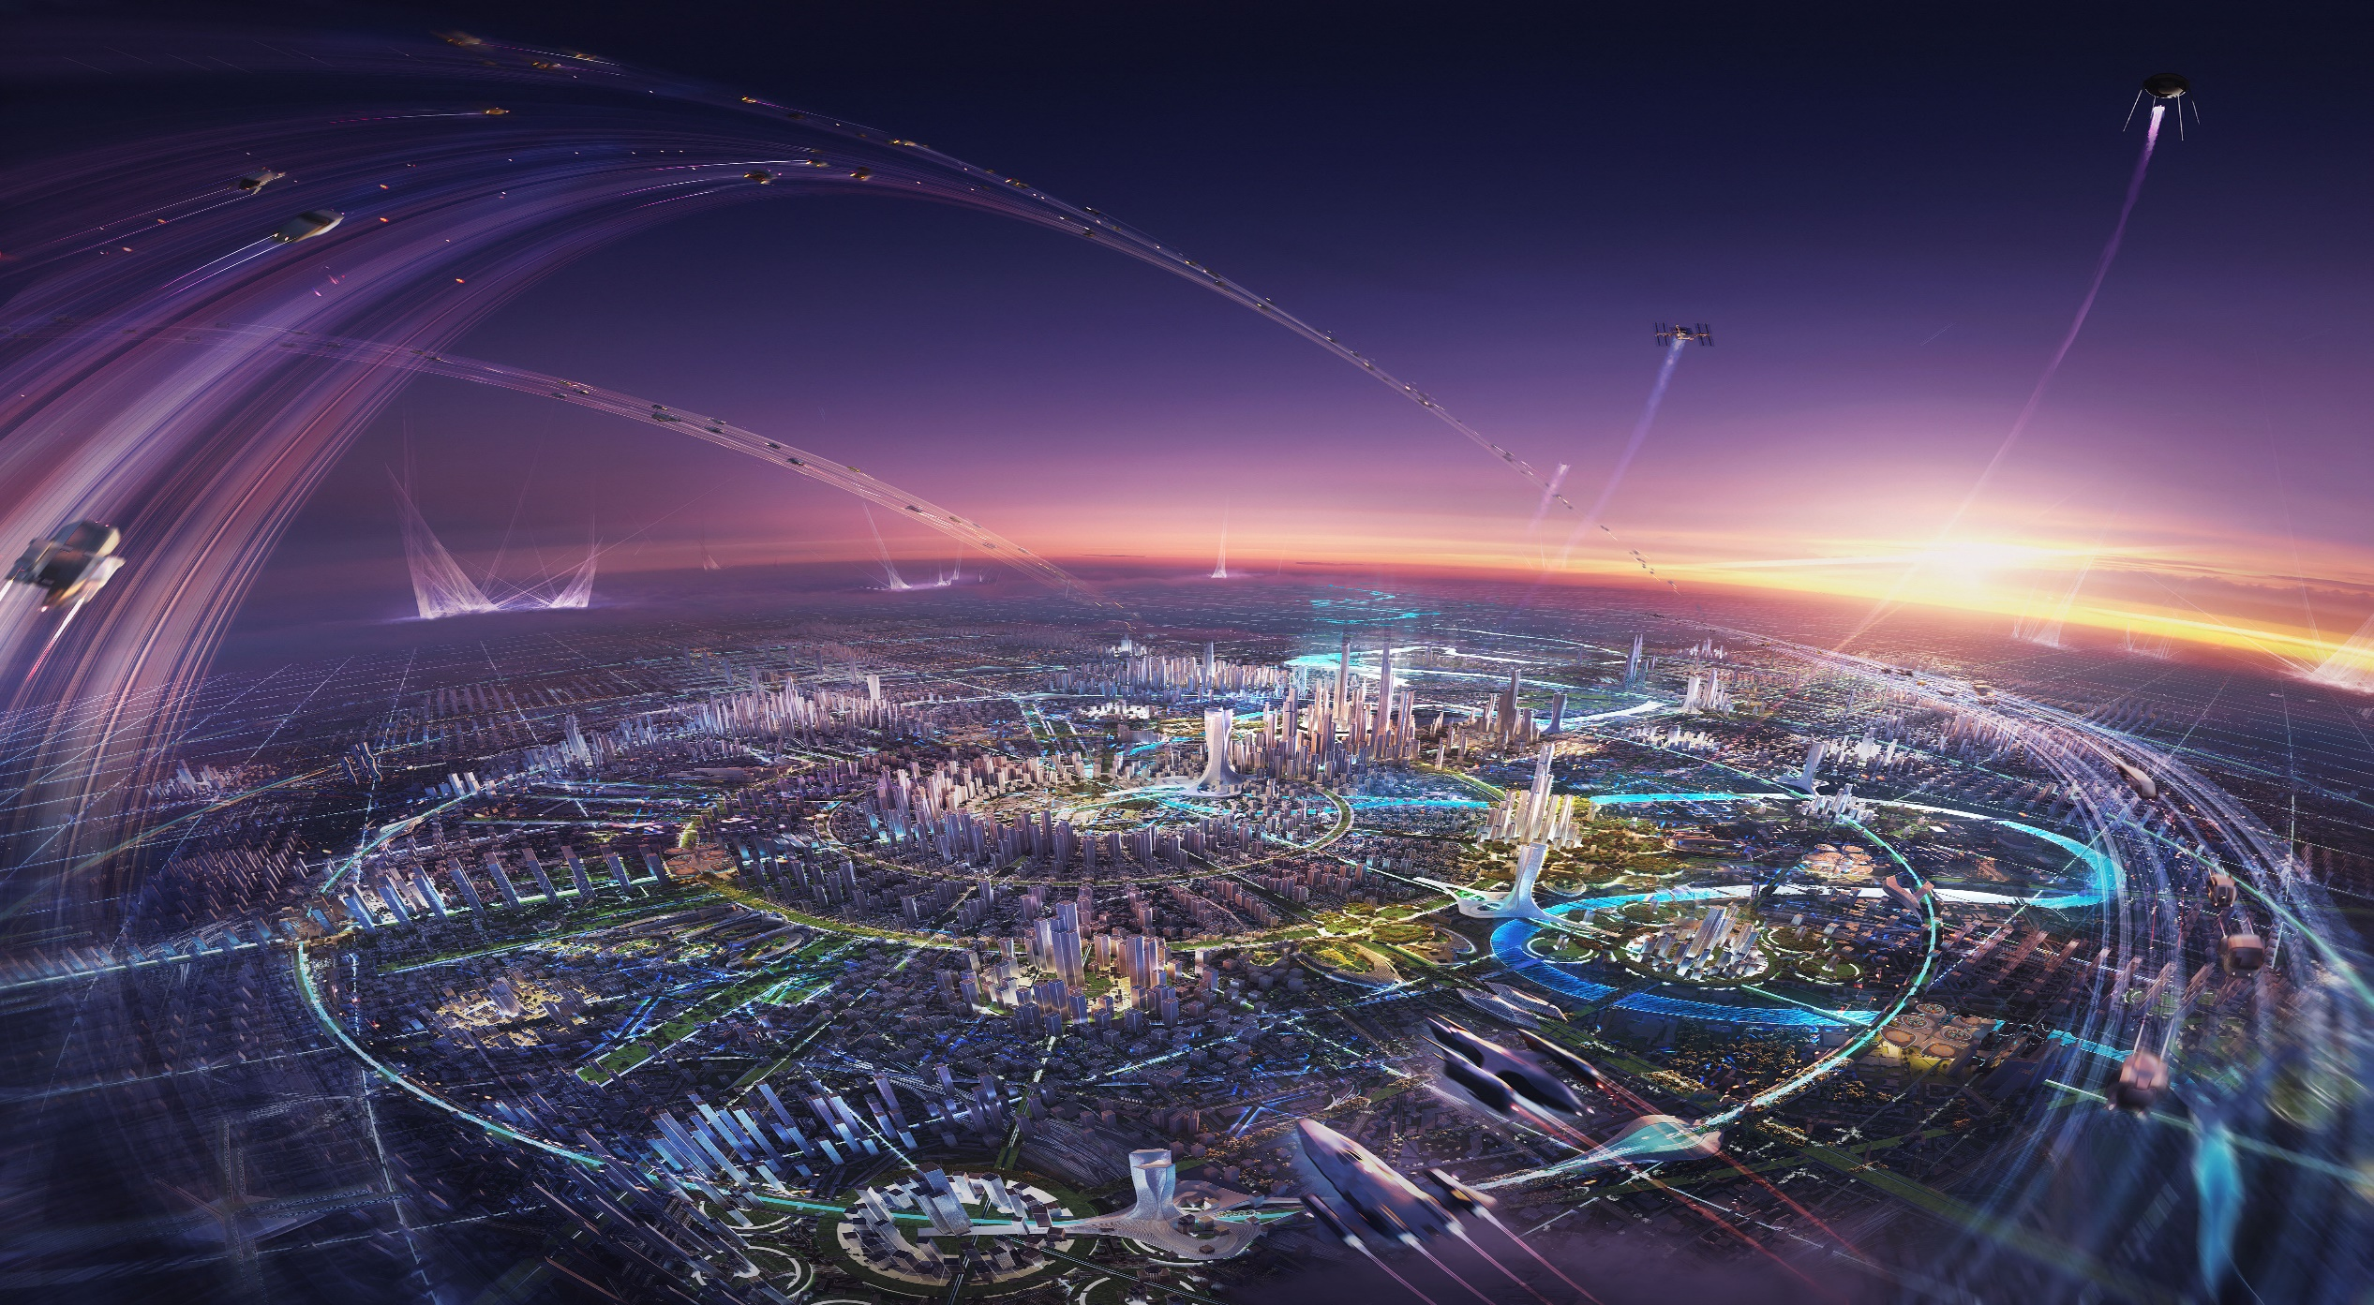
ECO-TECH habitats places for human interaction embedded in the local landscape
High-tech Agricultural citadel, 2018

